Slide 1
Friday, December 9, 2016
Write In Your Agenda:
Write In Your Monitoring Log:
CW:
100 Greatest Discoveries: Astronomy video and video sheet
HW:
Study for Seasons Quiz on Thursday 12/15/16.
Response to Warm-Up:
Describe one discovery/invention that has changed your life.
You will need:
Pencil
Hand in: Seasons Flip Book and Seasons Crossword Puzzle and Word Search

Slide 2
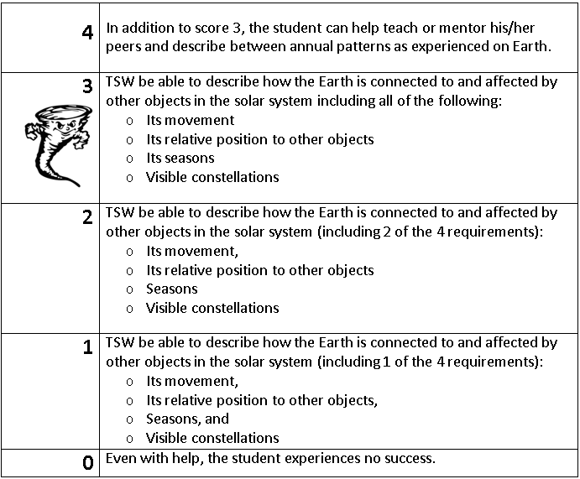
Learning Goal and Scale
TSW be able to describe how the Earth is connected to and affected by other objects in the solar system (including its movement, its relative position to other objects, its seasons, and visible constellations).

